Slide 1

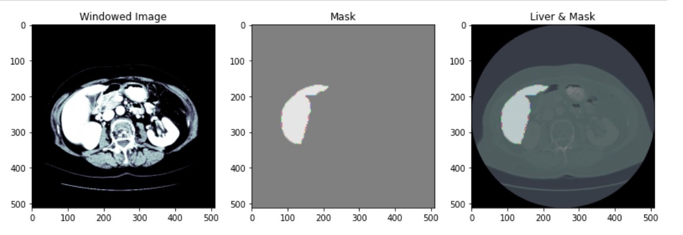
LITS Segmentation
1st September 2021
Abhilash Datta
Fairy Mathur

Slide 2
Main Task
We are segmenting out the liver from a CT scan volume using a UNET model.
LITS dataset consists of 131 CT scan volumes of liver and its segmentations.
We are fine-tuning fastai’s pretrained UNET Model for Liver Segmentation.

Slide 3
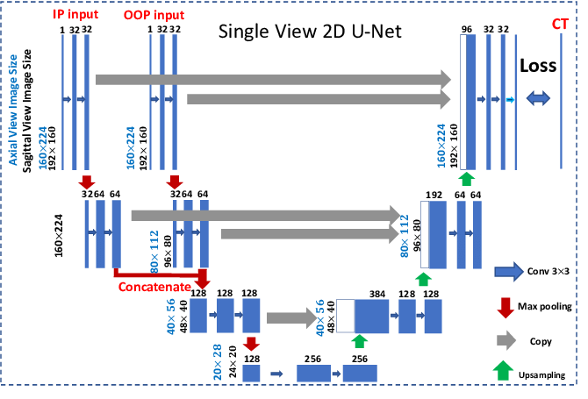
Glimpse of UNET Model

Slide 4
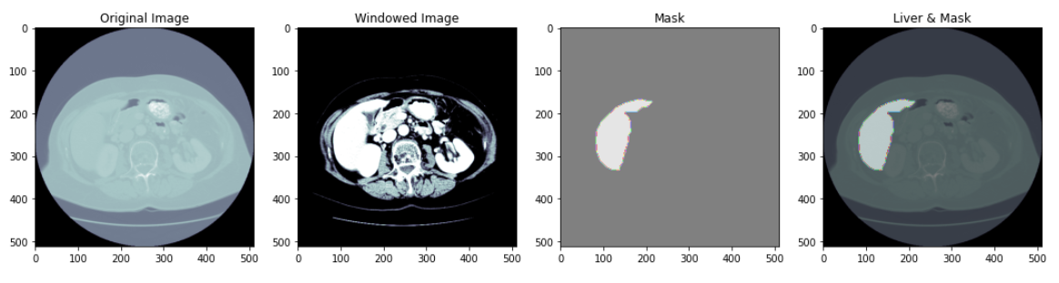
Glimpse of Data
The dataset consist of 131 CT scan volumes and segmentations of liver

Slide 5
Data Generation and Training Strategy
Each of the 131 liver CT scan volumes contains 75 channels.
Training a 2D UNET with 131 x 75 2D images would yield better results as compared to training a 3D UNET with only 131 images.
We also augmented the 2D images to generate sufficient images for our training.
For generating sufficient data for training.

Slide 6
Transfer
Learning
In transfer learning, a machine exploits the knowledge gained from a previous task to improve generalization about another.
We can achieve higher accuracies via fine-tuning pretrained models.

Slide 7
Fine - Tuning Fastai’s UNET Learner
99.8%
Foreground
Accuracy
Reached 99.8% accuracy only in 5 epoch

Slide 8
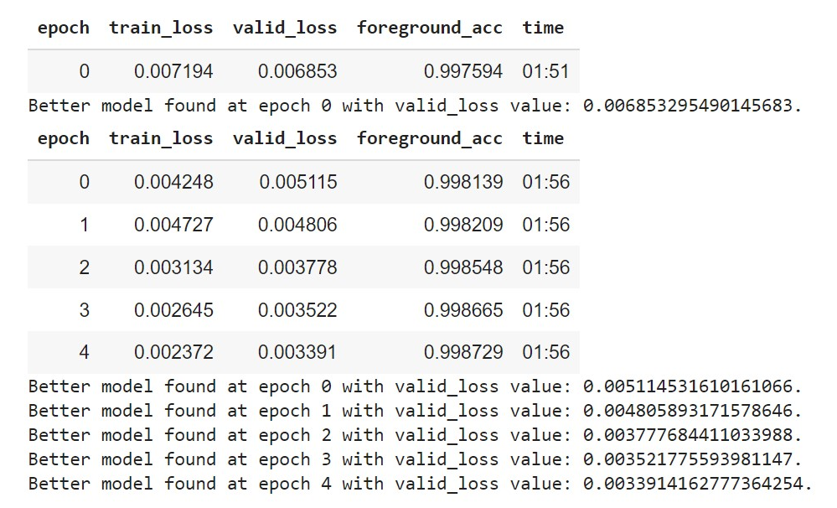
Training

Slide 9
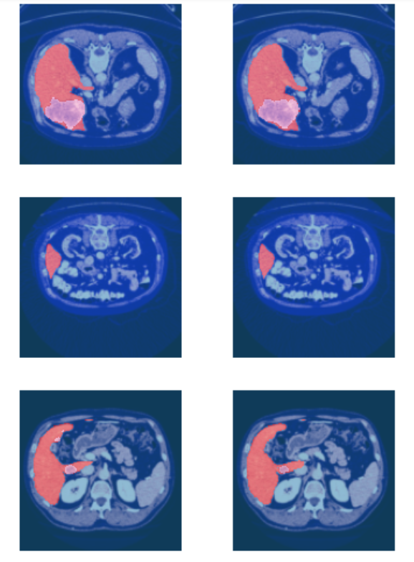
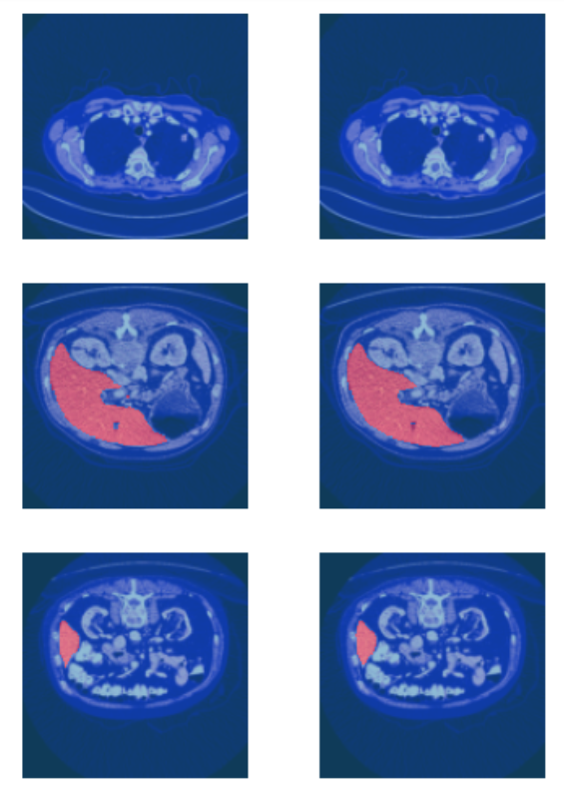
Results
Actual
Predicted
Actual
Predicted

Slide 10
That’s All!
Innovative Ideas are welcomed anytime.
Thank You

